Slide 1
Checking your online date
Verification OSINT Style

Slide 2





Slide 3






Slide 4


=

Slide 5
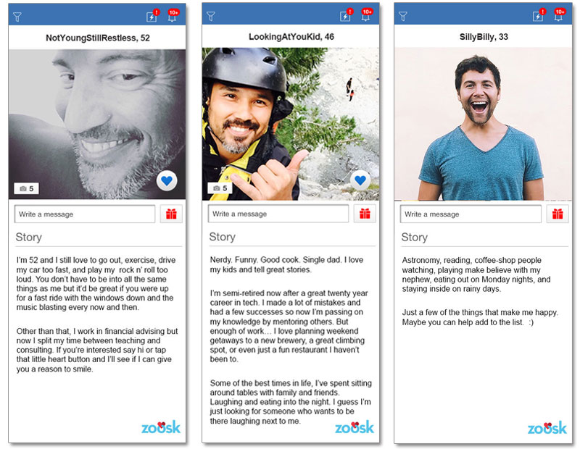

Slide 6
1
2
3

Slide 7
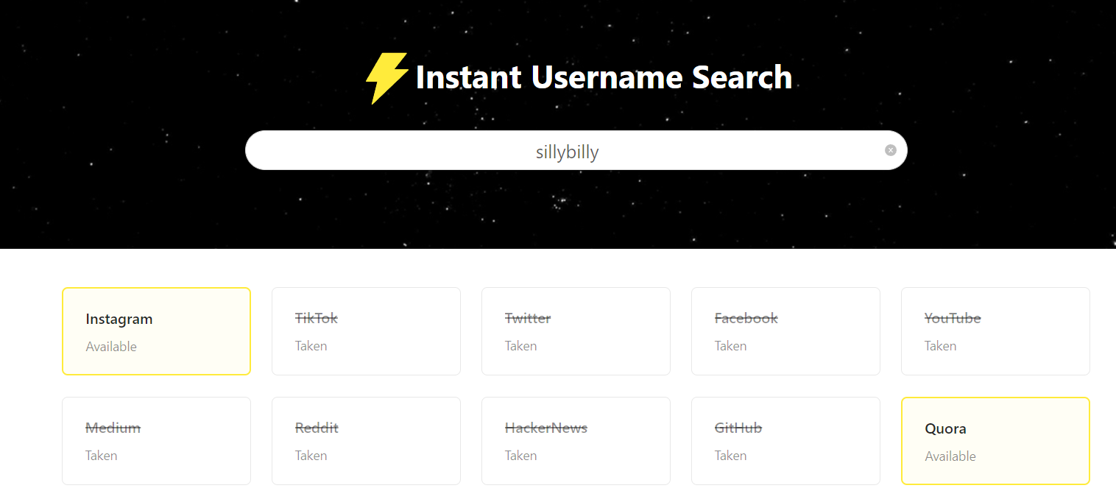
https://instantusername.com/

Slide 8
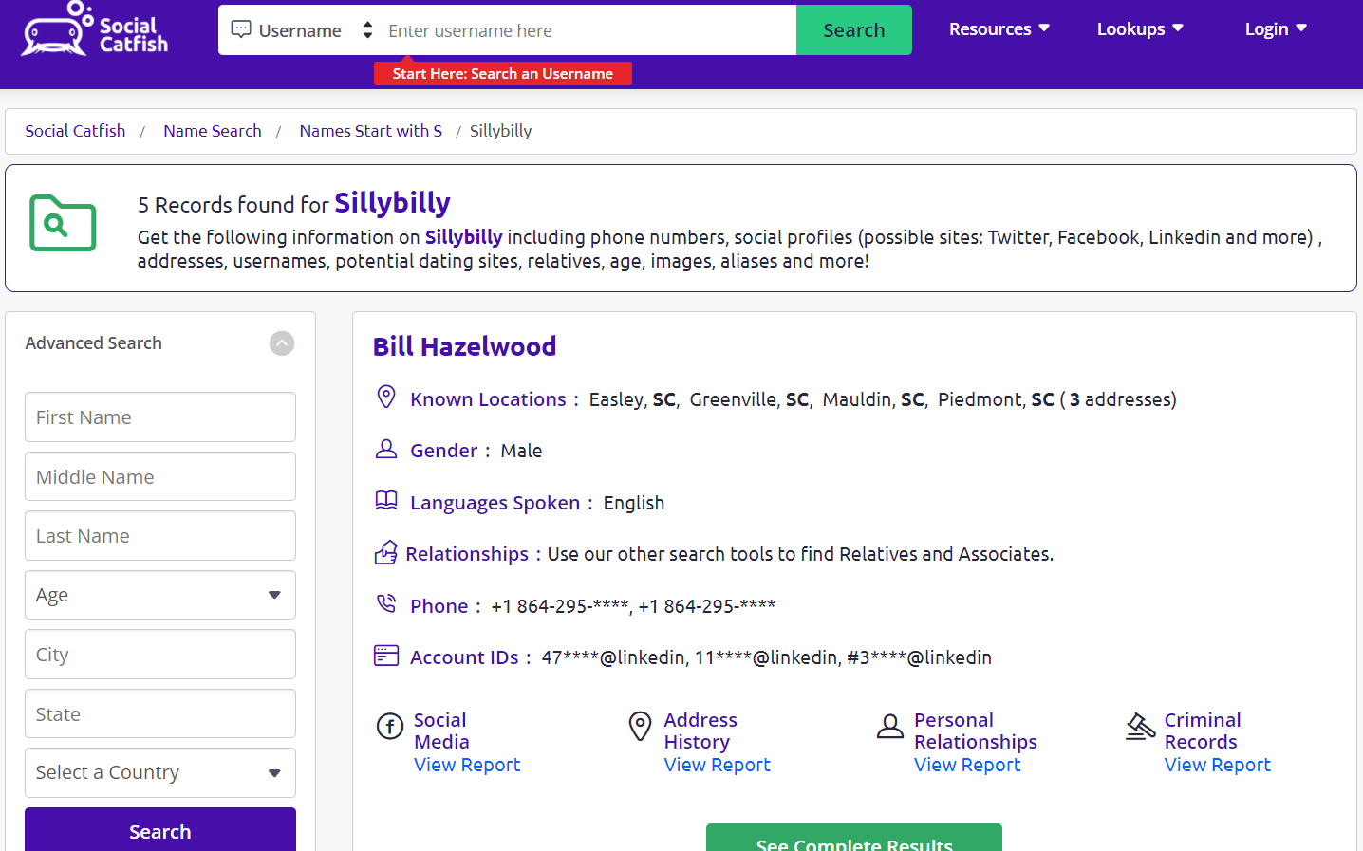
https://socialcatfish.com/reverse-username-search/

Slide 9




Slide 10
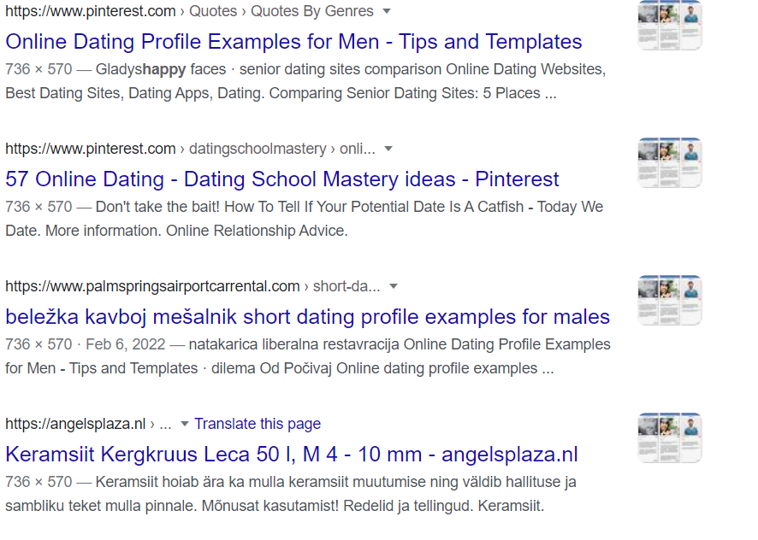

Slide 11
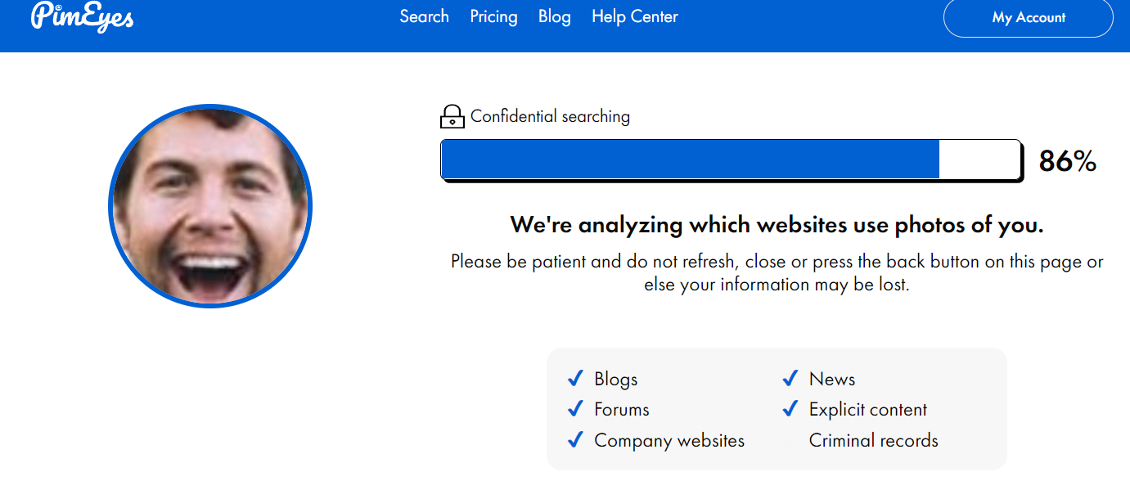
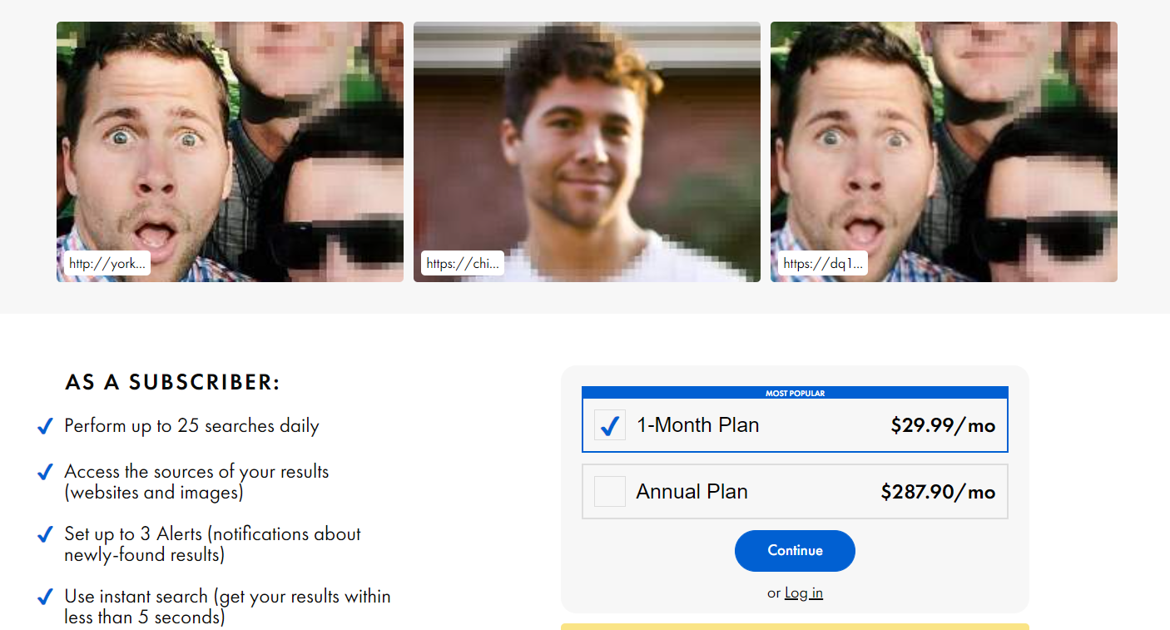

Slide 12
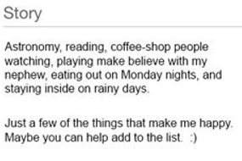
Break down post for useful information
Is the post generic? (May be a bot)
Unusual grammar or spelling mistakes?
Information differs from the rest of the
Profile?

Slide 13
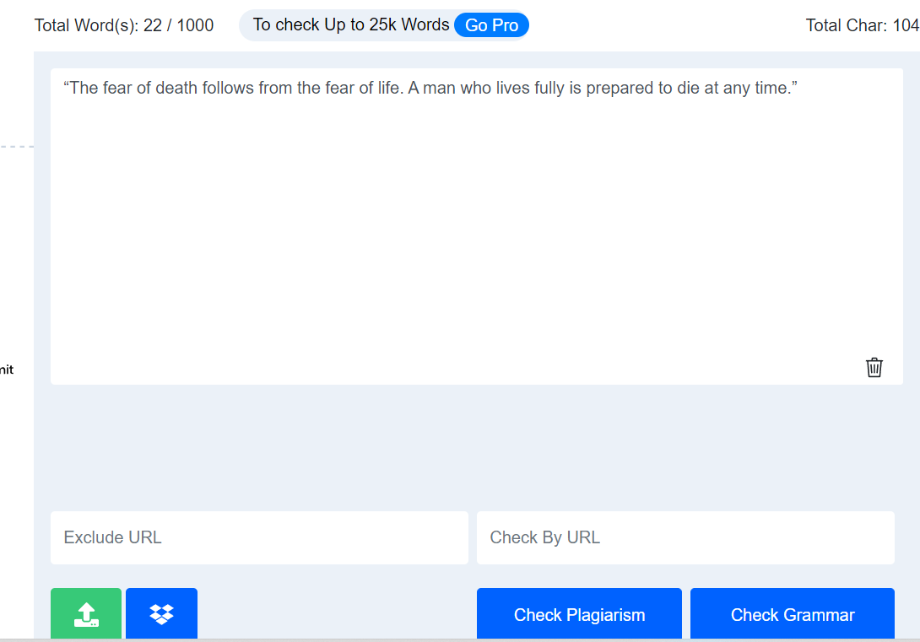
https://plagiarismdetector.net/

Slide 14
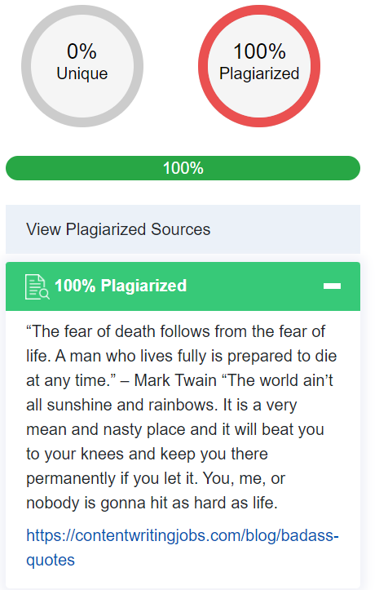

Slide 15

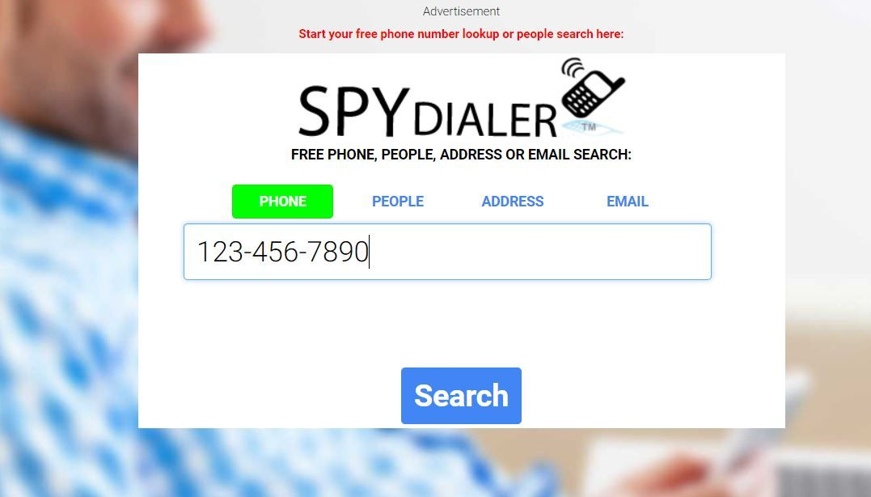


Slide 16
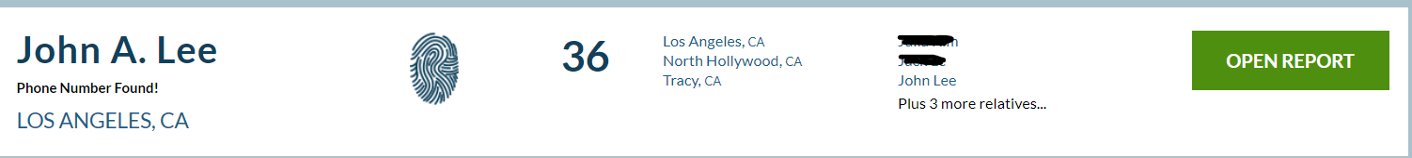

Slide 17
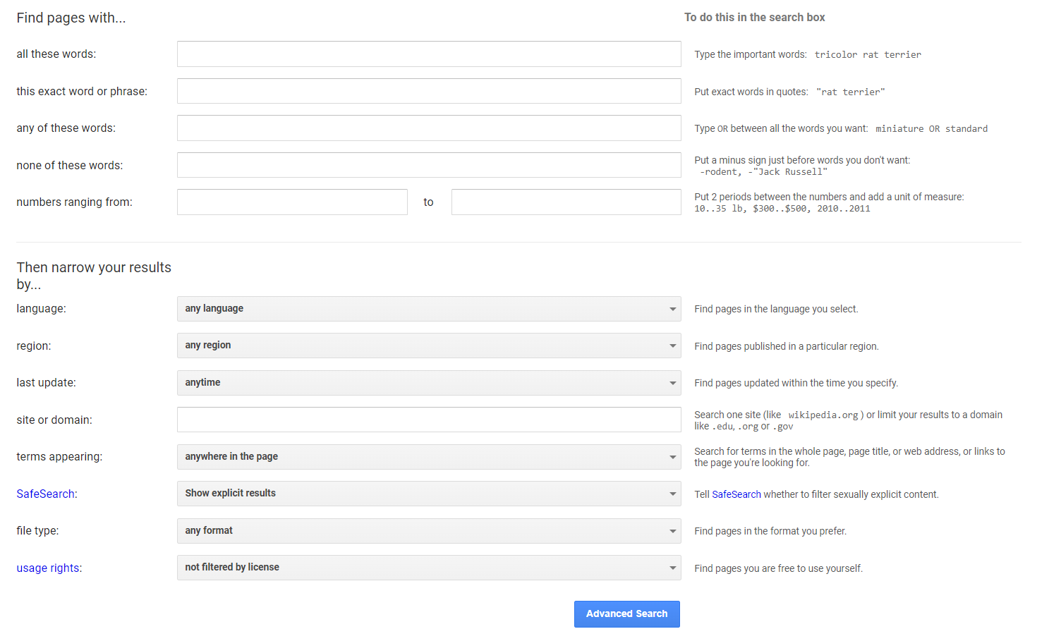
https://www.google.com/advanced_search

